Slide 1
Archaeological Site Prediction
Wiebke Engler
10.7.2025

Slide 2
introduction
Kaggle dataset called: Egypt. Possible Archaeological Sites A.I.
Potential sites pre selected:
Anomality detection
Regression

Slide 3
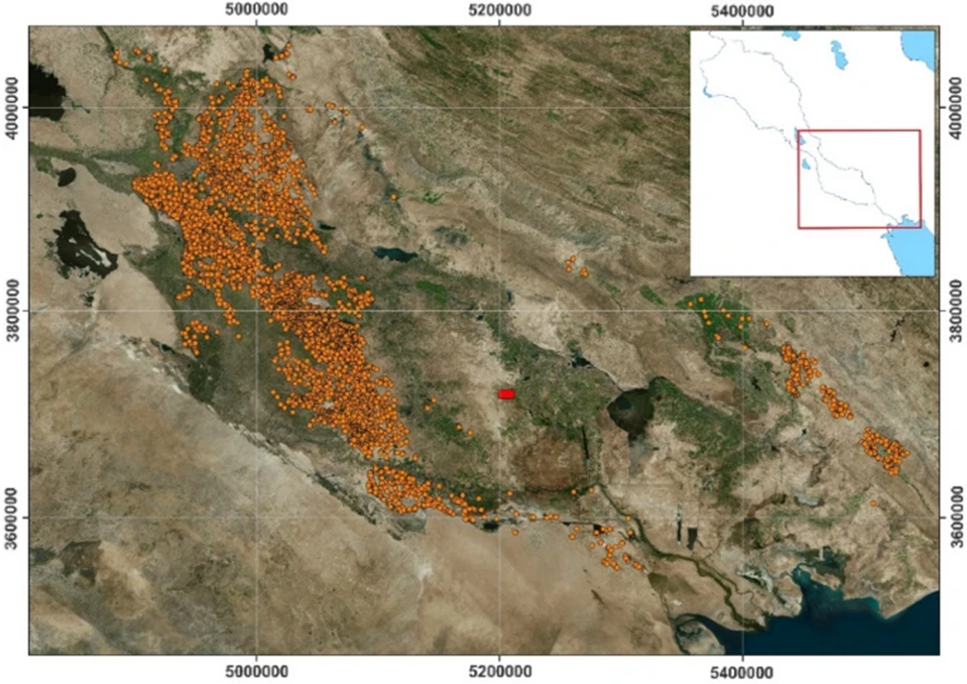
Literature review
Often Computer vision:
Prioritise and select potential excavation sites
Often done with satalite or LiDar images
Archaeoinformatics emerging field
Casini, L., Marchetti, N., Montanucci, A. et al. A human–AI collaboration workflow for archaeological sites detection. Sci Rep 13, 8699 (2023). https://doi.org/10.1038/s41598-023-36015-5

Slide 4
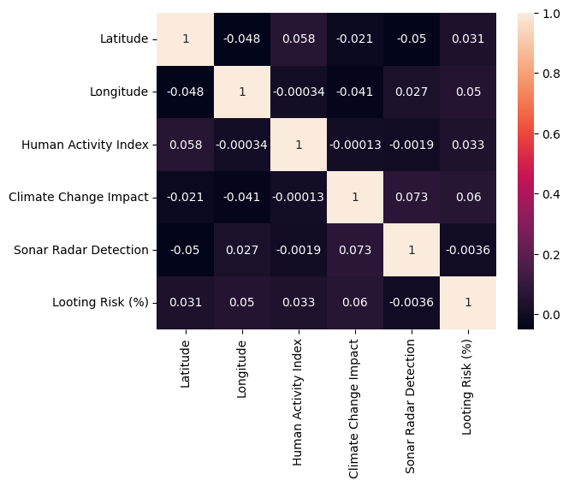
DATA SET CHARACTERISTICS
500 entries
No missing values
Normalizing continuous and encode categorical data
Types of material, script and time period
AI prediction score

Slide 5


Baseline Model
One class anomality/novaltiy detection (Stochastic Gradient Descent)
Synthetic test data with values outside of the positive cases
Did not really work, almost everything was classified as inlier
Linear regression model
Mape 16.74%

Slide 6
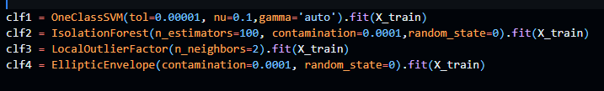
Model Definition and Evaluation
Different types of unsupervised one class detection
One class: High-dimensional distribution
Isolation forrest: randomly selct split value in range recursive to define inliers
Local outlier: distanctes to neighbours to define inlier area
Elleptic Envelope: Intended for Gaussian distributions

Slide 7
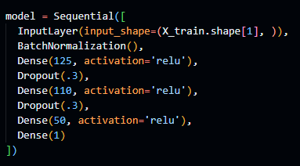
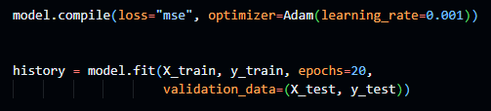
Model Definition and Evaluation
Linear regression with the given AI prediction score as goal

Slide 8
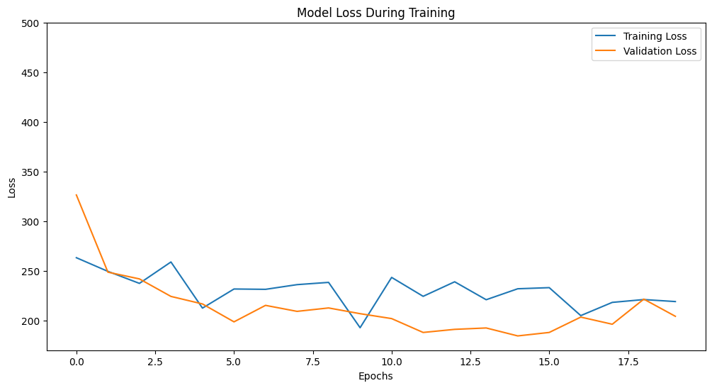
Model Definition and Evaluation
Even with more epochs keeps fluctuating similarly

Slide 9
Results
Model Corretly labled | OneClassSVM | IsolationForest | LocalOutlierFactor | EllipticEnvelope
Test data | 89% | 99% | 100% | 99%
Synthetic negative data | 10% | 2% | 12% | 2%

Slide 10
Results
Similar MAPEs but baseline model performes slightly better
MAPE | Baseline model | Model
Training data | 16.74% | 18.75%
Evaluation data | - | 17.46%

Slide 11
Challenges and Errors
Small data set
Not the complete data set
One class
Health issues

Slide 12
Discussion
Outlier detection does not seem to work well
-> Potentially an issue of the synthetic data
Similar Mapes for linear regression
Larger data set

Slide 13
Conclusion and Future Work
Find high interest excavation sites at risk:
Growing cities
Erosion
Rising water levels

Slide 14
Q&A

